Slide 1


Deep Neural Network
Neha Baranwal

Slide 2
About this course
1st day: lectures + small-scale exercises using colab notebooks
1. Introduction to deep learning and ANN and Its excersice
2. Introduction to Tensorflow
3. CNN
2nd day: lectures + excersices using colab
1. CNN excersice
2. Graph Neural Network
3. RNN+LSTM and its excersice
3rd day: lectures + excersices using colab
1- Unsupervised Learning
2- Reinforcement Learning
https://github.com/Neha-Baranwal/Deep_Learning_Workshop

Slide 3

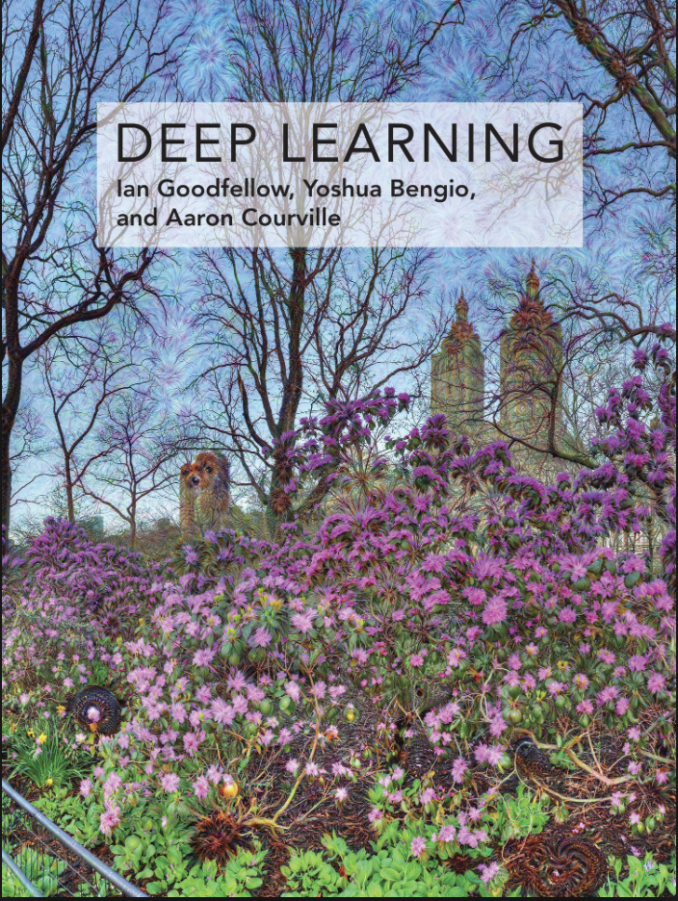
Further resources
This course is largely “inspired by”: “Deep Learning with Python” by François Chollet
Recommended textbook: “Deep learning” by Goodfellow, Bengio, Courville
Lots of further material available online, e.g.: https://github.com/oxford-cs-deepnlp-2017/lectures http://cs231n.stanford.edu/ http://course.fast.ai/ https://developers.google.com/machine-learning/crash-course/ www.nvidia.com/dlilabs http://introtodeeplearning.com/ https://www.youtube.com/user/neubig/videos
Academic courses

Slide 4



Machine Learning vs Deep Learning
AI
ML
DL
Artificial intelligence is the ability of a computer to perform tasks commonly associated with intelligent beings. (John McCarthy, 1956)
Machine learning is the study of algorithms that learn from examples and experience instead of relying on hard-coded rules and make predictions on new data.(Arthur Samuel, 1959)
Deep learning is a subfield of machine learning focusing on learning data representations as successive layers of increasingly meaningful representations.

Slide 5

Why Deep Learning
“Traditional” machine learning:
handcrafted features
learned classifier
cat
Deep, “end-to-end” learning:
learned low-level features
learned mid-level features
learned high-level features
learned classifier
cat

Slide 6
Applications of Deep Neural Network
Image Classification
Object Detection
Segmentation
Seen Identification
Stock Market Prediction
Mental Health Prediction
Early Detection of Neurological Gait Abnormalities
Sentiment Analysis
Invoice Processing
Computer Vision
Time Series
NLP

Slide 7
ANN Discussion Points
How brain works
Similarity between brain and artificial neural network
Perceptron learning
AND
OR
XOR
Multilayer Perceptron

Slide 8
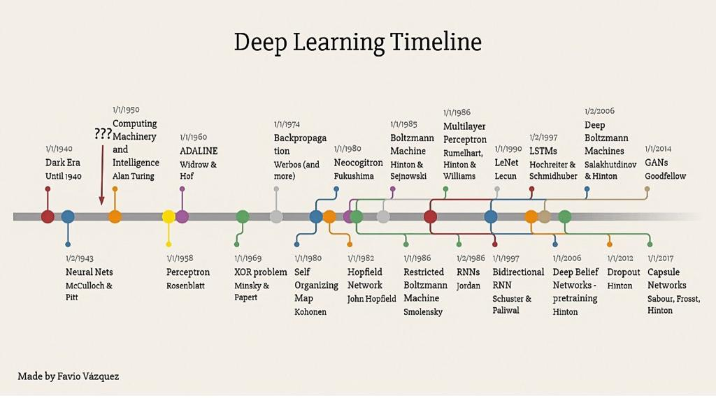
History of ANN

Slide 9
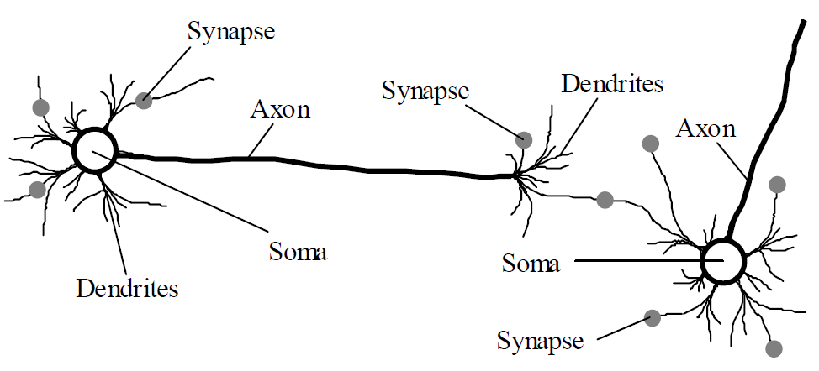
How Brain Works
The human brain incorporates nearly 10 billion neurons and 60 trillion connections, synapses, between them.
A neuron consists of a cell body, soma, a number of fibers called dendrites, and a single long fiber called the axon.

Slide 10
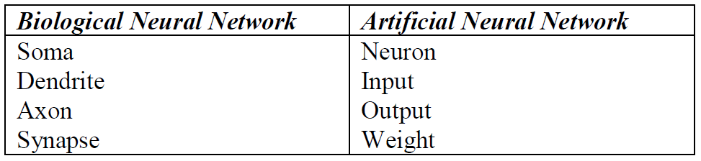
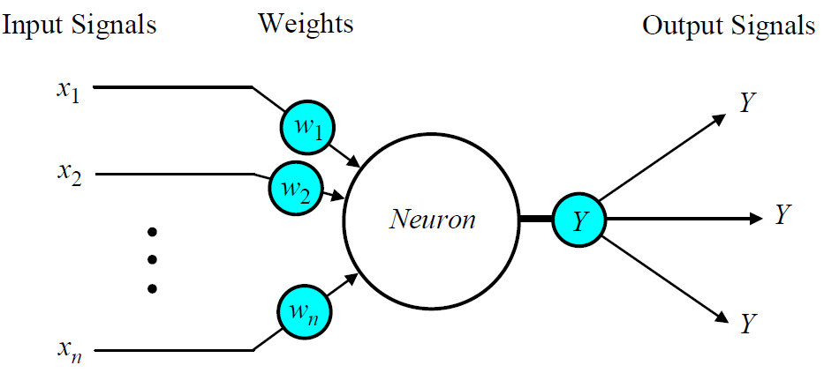
Similarity between brain and ANN

Slide 11
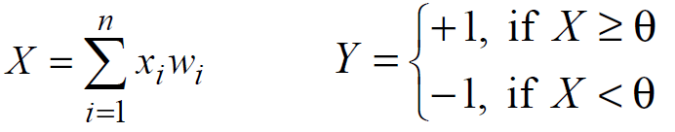
Perceptron Learning
1
2
Sign Function

Slide 12
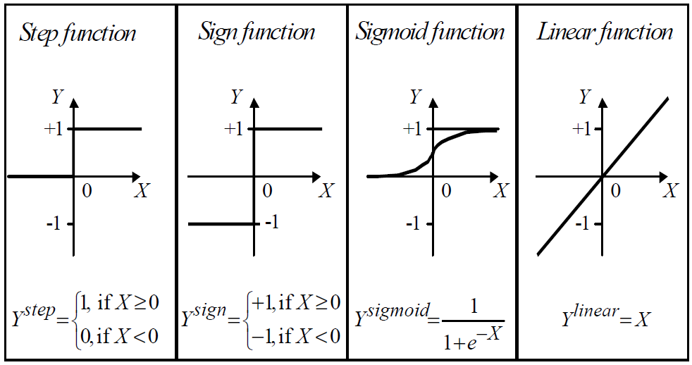
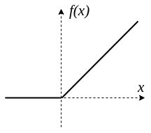
Activation Functions
Relu Function
F(x)=max(0,x)

Slide 13
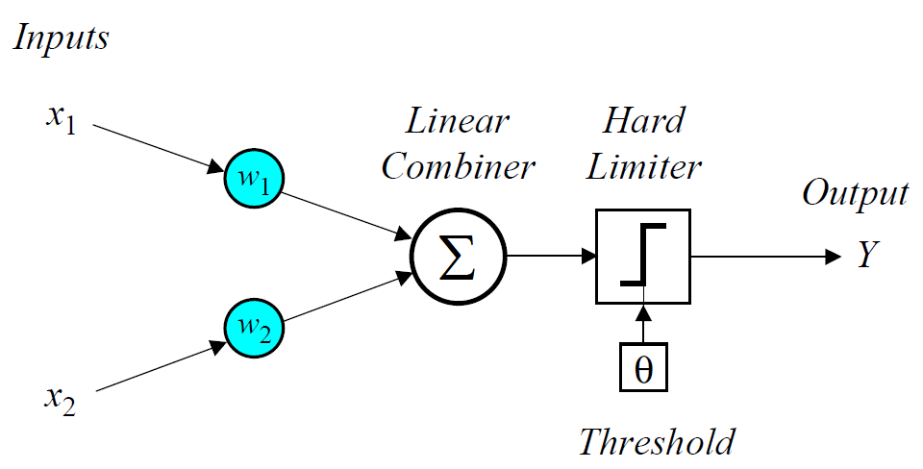
How a perceptron learns
In 1958, Frank Rosenblatt introduced a training algorithm that provided the first procedure for training a simple ANN: a perceptron,
inspired by
McCulloch and Pitts neuron model

Slide 14
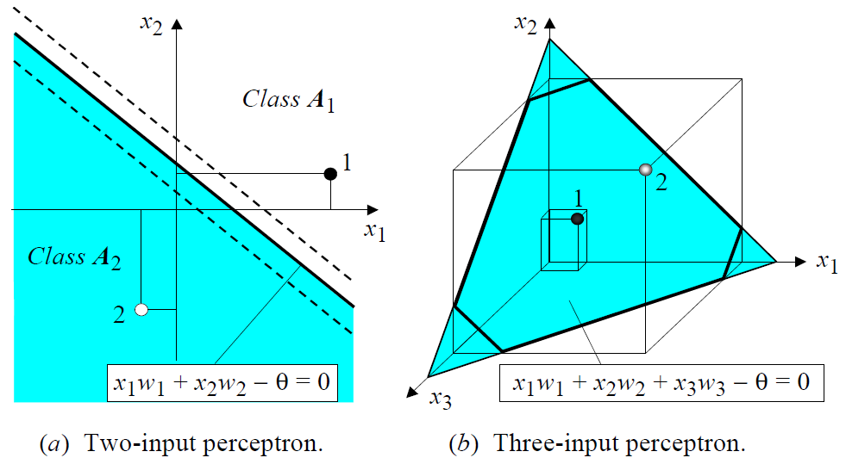
How a perceptron learns
Decision boundary

Slide 15
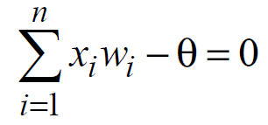
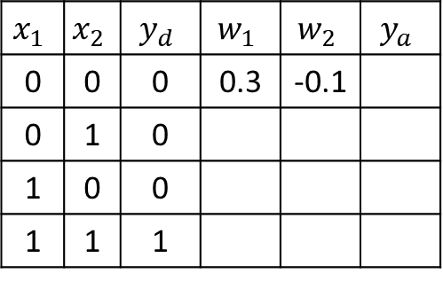
How a perceptron learns
AND Problem
$$x_{1}$$ | $$x_{2}$$ | $$y_{d}$$ | $$w_{1}$$ | $$w_{2}$$ | $$y_{a}$$
0 | 0 | 0 | 0.3 | -0.1
0 | 1 | 0
1 | 0 | 0
1 | 1 | 1
3
1
3
2
Step( )
1
2
Threshold: θ = 0.2; learning rate : α = 0.1; activation function : step

Slide 16
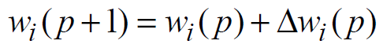
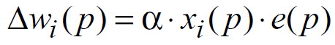
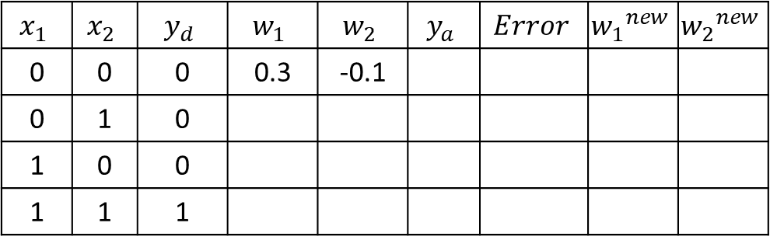
How a perceptron learns
$$x_{1}$$ | $$x_{2}$$ | $$y_{d}$$ | $$w_{1}$$ | $$w_{2}$$ | $$y_{a}$$ | $$Error$$ | $${w_{1}}^{new}$$ | $${w_{2}}^{new}$$
0 | 0 | 0 | 0.3 | -0.1
0 | 1 | 0
1 | 0 | 0
1 | 1 | 1
Weight Updation
Threshold: θ = 0.2; learning rate : α = 0.1; activation function : step

Slide 17
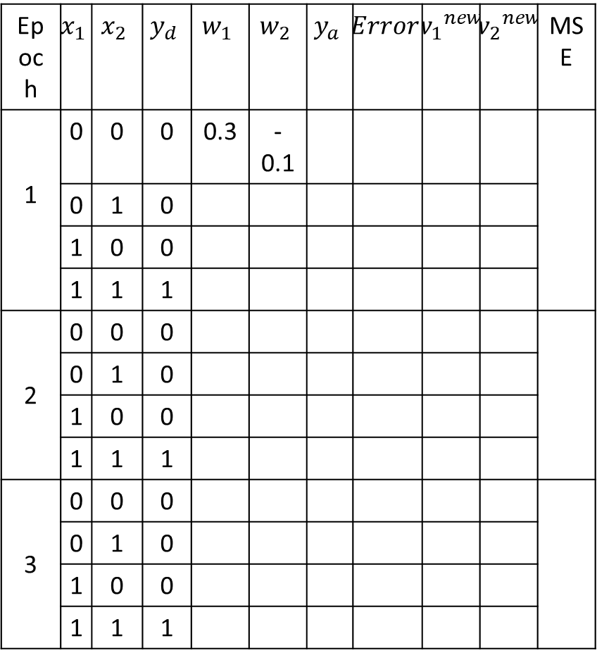
How a perceptron learns
Epoch | $$x_{1}$$ | $$x_{2}$$ | $$y_{d}$$ | $$w_{1}$$ | $$w_{2}$$ | $$y_{a}$$ | $$Error$$ | $${w_{1}}^{new}$$ | $${w_{2}}^{new}$$ | MSE
1 | 0 | 0 | 0 | 0.3 | -0.1
1 | 0 | 1 | 0
1 | 1 | 0 | 0
1 | 1 | 1 | 1
2 | 0 | 0 | 0
2 | 0 | 1 | 0
2 | 1 | 0 | 0
2 | 1 | 1 | 1
3 | 0 | 0 | 0
 | 0 | 1 | 0
 | 1 | 0 | 0
 | 1 | 1 | 1

Slide 18
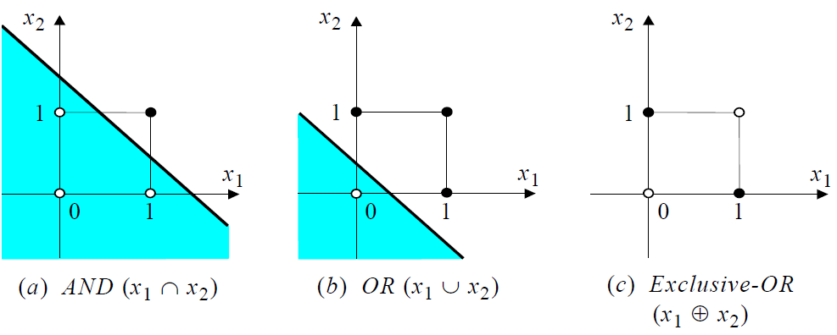
How a perceptron learns : Decision Boundary

Slide 19
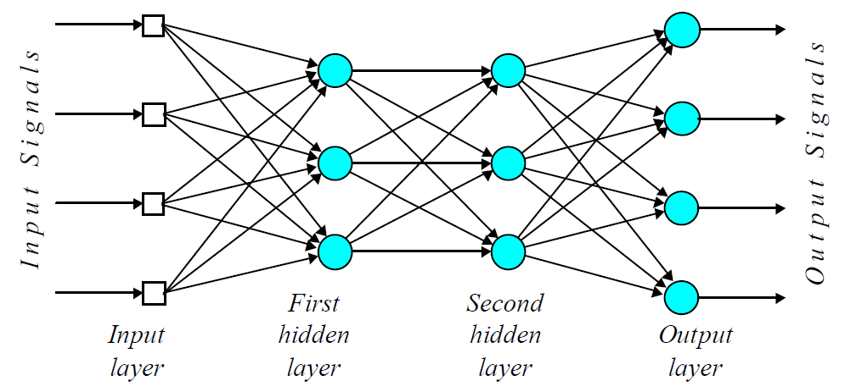
Multi Layer Perceptron

Slide 20
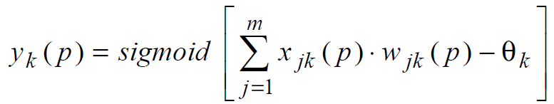
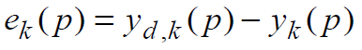
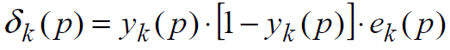
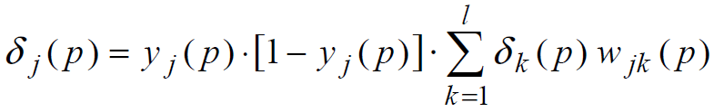
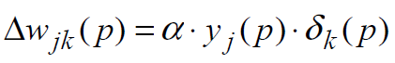
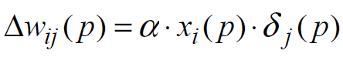
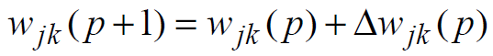
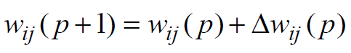
Multi Layer Perceptron: Weight Updation
Neuron out at layer “k”
Error at layer “k”
Error gradient at layer “k”
Error gradient at layer “j”
Change in weight
Change in weight
Weight Updation
Weight Updation

Slide 21
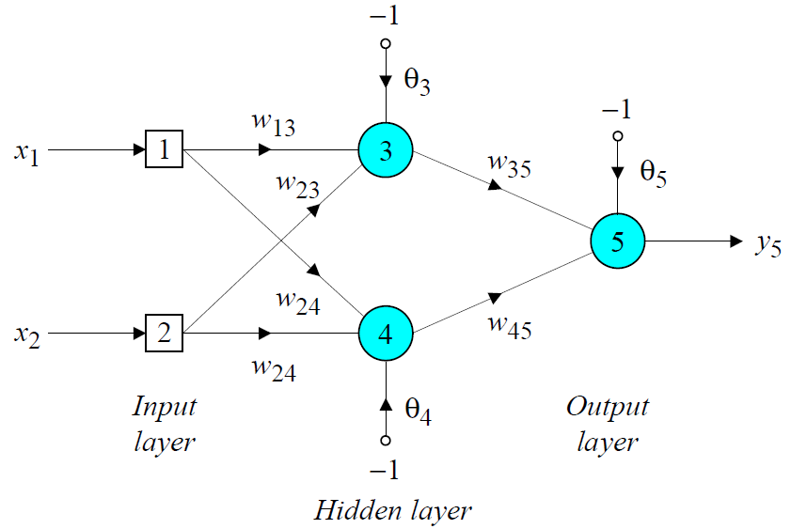
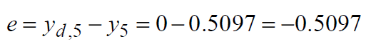
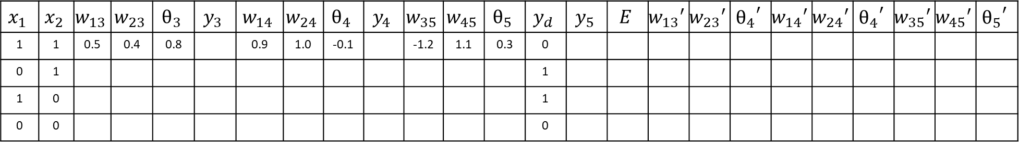
XOR Problem
$$x_{1}$$ | $$x_{2}$$ | $$w_{13}$$ | $$w_{23}$$ | $$θ_{3}$$ | $$y_{3}$$ | $$w_{14}$$ | $$w_{24}$$ | $$θ_{4}$$ | $$y_{4}$$ | $$w_{35}$$ | $$w_{45}$$ | $$θ_{5}$$ | $$y_{d}$$ | $$y_{5}$$ | $$E$$ | $${w_{13}}^{′}$$ | $${w_{23}}^{′}$$ | $${θ_{4}}^{′}$$ | $${w_{14}}^{′}$$ | $${w_{24}}^{′}$$ | $${θ_{4}}^{′}$$ | $${w_{35}}^{′}$$ | $${w_{45}}^{′}$$ | $${θ_{5}}^{′}$$
1 | 1 | 0.5 | 0.4 | 0.8 |  | 0.9 | 1.0 | -0.1 |  | -1.2 | 1.1 | 0.3 | 0
0 | 1 |  |  |  |  |  |  |  |  |  |  |  | 1
1 | 0 |  |  |  |  |  |  |  |  |  |  |  | 1
0 | 0 |  |  |  |  |  |  |  |  |  |  |  | 0

Slide 22
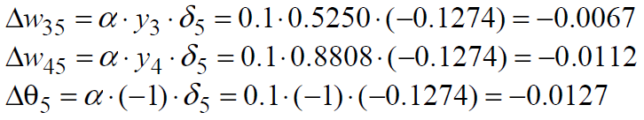
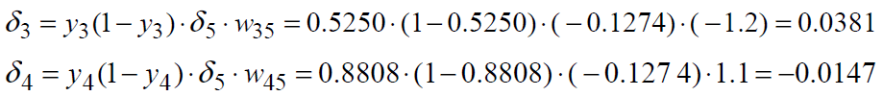
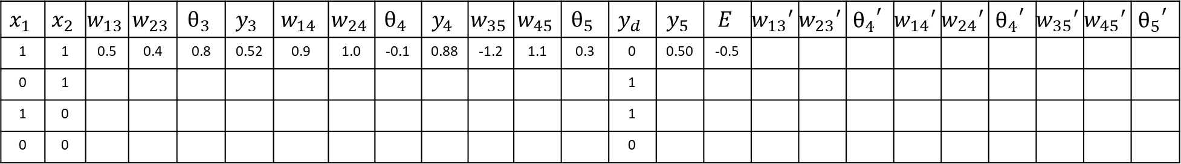
XOR Problem
$$x_{1}$$ | $$x_{2}$$ | $$w_{13}$$ | $$w_{23}$$ | $$θ_{3}$$ | $$y_{3}$$ | $$w_{14}$$ | $$w_{24}$$ | $$θ_{4}$$ | $$y_{4}$$ | $$w_{35}$$ | $$w_{45}$$ | $$θ_{5}$$ | $$y_{d}$$ | $$y_{5}$$ | $$E$$ | $${w_{13}}^{′}$$ | $${w_{23}}^{′}$$ | $${θ_{4}}^{′}$$ | $${w_{14}}^{′}$$ | $${w_{24}}^{′}$$ | $${θ_{4}}^{′}$$ | $${w_{35}}^{′}$$ | $${w_{45}}^{′}$$ | $${θ_{5}}^{′}$$
1 | 1 | 0.5 | 0.4 | 0.8 | 0.52 | 0.9 | 1.0 | -0.1 | 0.88 | -1.2 | 1.1 | 0.3 | 0 | 0.50 | -0.5
0 | 1 |  |  |  |  |  |  |  |  |  |  |  | 1
1 | 0 |  |  |  |  |  |  |  |  |  |  |  | 1
0 | 0 |  |  |  |  |  |  |  |  |  |  |  | 0

Slide 23
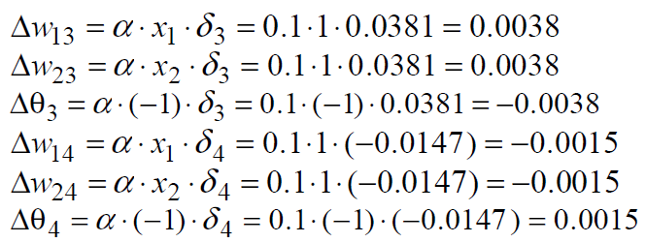
XOR Problem
$$x_{1}$$ | $$x_{2}$$ | $$w_{13}$$ | $$w_{23}$$ | $$θ_{3}$$ | $$y_{3}$$ | $$w_{14}$$ | $$w_{24}$$ | $$θ_{4}$$ | $$y_{4}$$ | $$w_{35}$$ | $$w_{45}$$ | $$θ_{5}$$ | $$y_{d}$$ | $$y_{5}$$ | $$E$$ | $${w_{13}}^{′}$$ | $${w_{23}}^{′}$$ | $${θ_{4}}^{′}$$ | $${w_{14}}^{′}$$ | $${w_{24}}^{′}$$ | $${θ_{4}}^{′}$$ | $${w_{35}}^{′}$$ | $${w_{45}}^{′}$$ | $${θ_{5}}^{′}$$
1 | 1 | 0.5 | 0.4 | 0.8 | 0.52 | 0.9 | 1.0 | -0.1 | 0.88 | -1.2 | 1.1 | 0.3 | 0 | 0.50 | -0.5
0 | 1 |  |  |  |  |  |  |  |  |  |  |  | 1
1 | 0 |  |  |  |  |  |  |  |  |  |  |  | 1
0 | 0 |  |  |  |  |  |  |  |  |  |  |  | 0

Slide 24
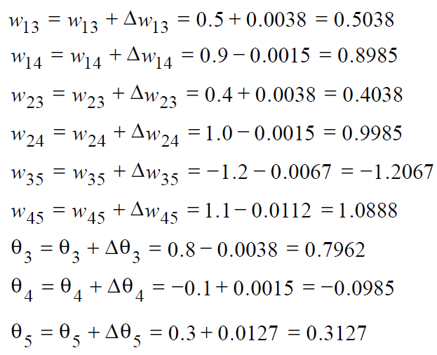
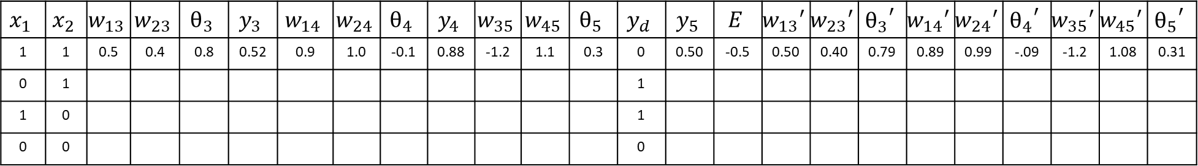
XOR Problem
$$x_{1}$$ | $$x_{2}$$ | $$w_{13}$$ | $$w_{23}$$ | $$θ_{3}$$ | $$y_{3}$$ | $$w_{14}$$ | $$w_{24}$$ | $$θ_{4}$$ | $$y_{4}$$ | $$w_{35}$$ | $$w_{45}$$ | $$θ_{5}$$ | $$y_{d}$$ | $$y_{5}$$ | $$E$$ | $${w_{13}}^{′}$$ | $${w_{23}}^{′}$$ | $${θ_{3}}^{′}$$ | $${w_{14}}^{′}$$ | $${w_{24}}^{′}$$ | $${θ_{4}}^{′}$$ | $${w_{35}}^{′}$$ | $${w_{45}}^{′}$$ | $${θ_{5}}^{′}$$
1 | 1 | 0.5 | 0.4 | 0.8 | 0.52 | 0.9 | 1.0 | -0.1 | 0.88 | -1.2 | 1.1 | 0.3 | 0 | 0.50 | -0.5 | 0.50 | 0.40 | 0.79 | 0.89 | 0.99 | -.09 | -1.2 | 1.08 | 0.31
0 | 1 |  |  |  |  |  |  |  |  |  |  |  | 1
1 | 0 |  |  |  |  |  |  |  |  |  |  |  | 1
0 | 0 |  |  |  |  |  |  |  |  |  |  |  | 0

Slide 25
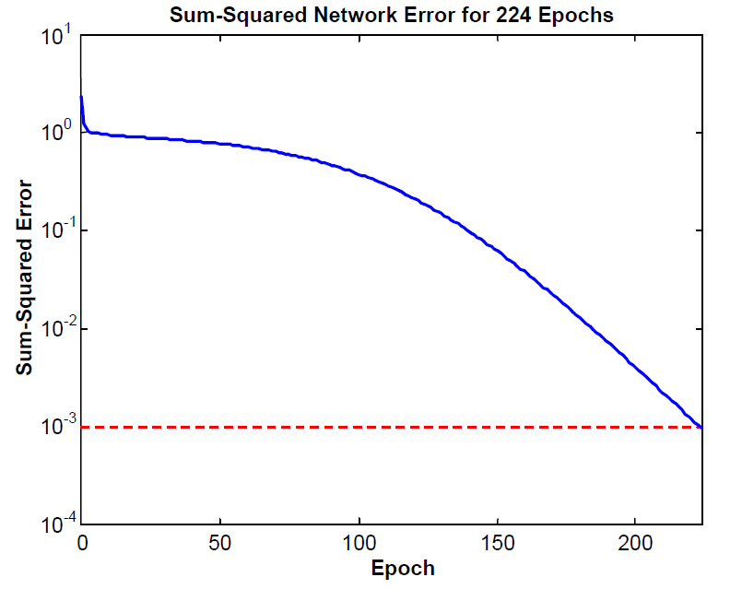
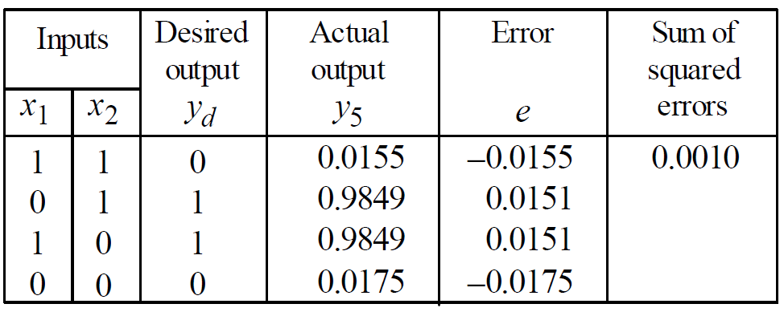
XOR Problem

Slide 26
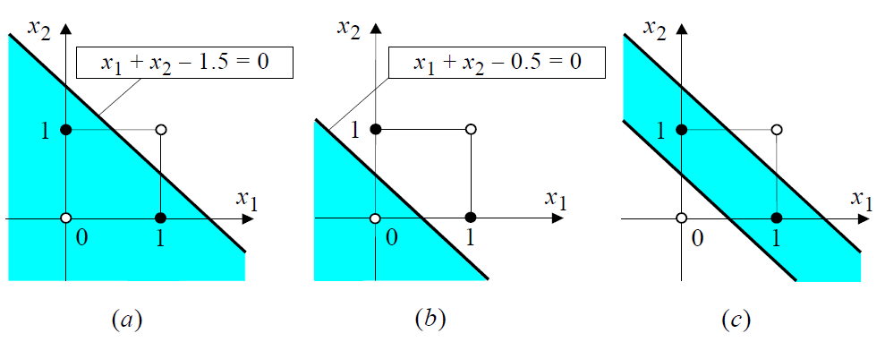
XOR Problem
a) Decision boundary created by hidden neuron 3
b) Decision boundary created by hidden neuron 4
c) Decision boundary created by output neuron 5

